Slide 1

Architectural Katas 2024
Team Low-Code

Slide 2
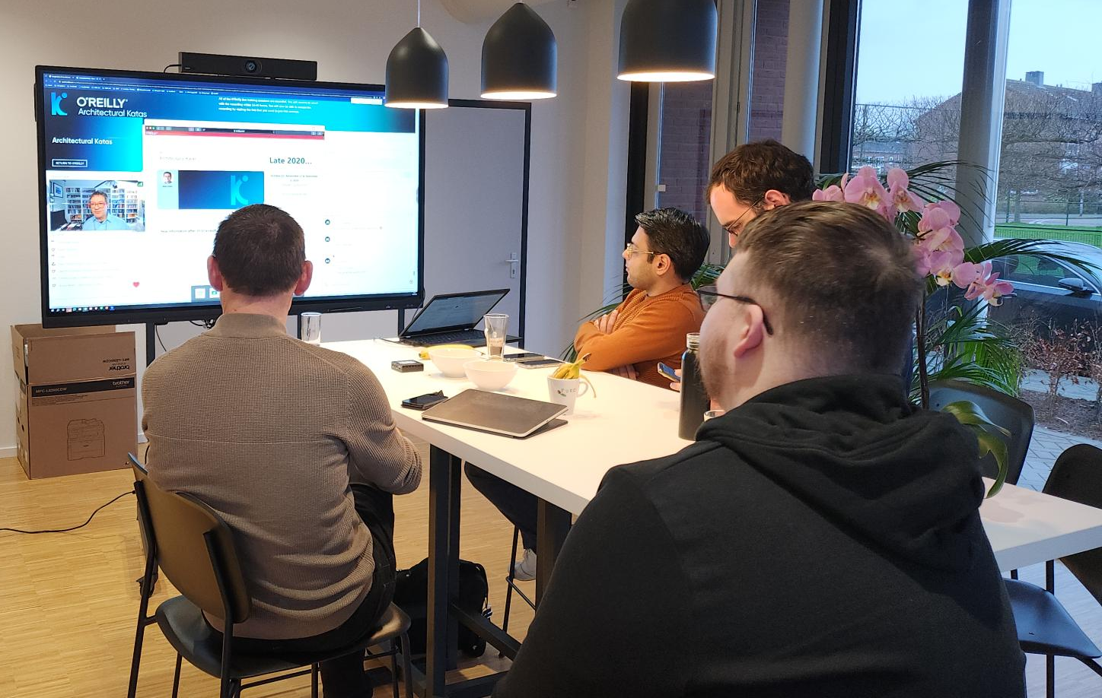

Slide 3
CONTENT
MonitorMe Business Case
Constraints & Driving Characteristics
Architectural Design Decisions
MonitorMe Solution

Slide 4
MonitorMe Business Case
Joachim

Slide 5
The Business Problem of StayHealty Inc.
MonitorThem data analytics platform
MonitorMe patient monitoring system
NEW
MyMedicalData patient medical record system
Notes:
StayHealthy, Inc. is a large and highly successful medical software company located in San Francisco, California, US.
Currently 2 popular cloud-based SAAS products:
MonitorThem a comprehensive data analytics platform that is used for hospital trend and performance analytics—alert response times, patient health problem analytics, patient recovery analysis, and so on.
MyMedicalData is a comprehensive cloud-based patient medical records system used by doctors, nurses, and other health professionals to record and track a patients health records with guaranteed partitioning between patient records.
StayHealthy, Inc. is now expanding into the medical monitoring market, and is in need of a new medical patient monitoring system for hospitals that monitors a patients vital signs using proprietary medical monitoring devices built by StayHealthy, Inc.

Slide 6
Requirements of MonitorMe
VITAL SIGN INPUT SOURCES
HEART RATE
BLOOD PRESSURE
OXYGEN LEVEL
BLOOD SUGAR
RESPIRATION
ECG
BODY TEMPERATURE
SLEEP STATUS
READ DATA VITAL SIGN INPUT SOURCES
RECORD & STORE DATA 24 HOURS
DIFFERENT RATE VITAL SIGNS READINGS
CONTINUITY IF AN INPUT SOURCE FAILS
ACCURATE MEASUREMENTS
MORE VITAL SIGN DEVICES

Slide 7
Requirements of MonitorMe
ANALYZE VITAL SIGNS & ALERT MEDICAL PROFESSIONAL
COMPLETE OWN INSTALLATION
MAX 500 PATIENTS PER INSTANCE
AWAKE OR ASLEEP TREND AND TRHESHOLDS
ON-PREMISES ARCHITECTURE
PUSH NOTIFICATION
TO MOBILE APP
BUILD-FOR-CHANGE
GENERATE HOLISTIC SNAPSHOTS
SECURE PATIENT DATA

Slide 8
Constraints & Driving Characteristics
Job

Slide 9
Driving Characteristics
Concurrency
Availability
Data integrity
Fault tolerance
Security
Performance
Responsiveness

Slide 10
24/7 correct simultaneous analysis of patient vital signs
Availability
Data integrity
Concurrency
100% uptime
Data loss = missing potential alerts
Time from data to alert
Correct data must be analyzed
No waiting queue
Simultaneous analysis

Slide 11
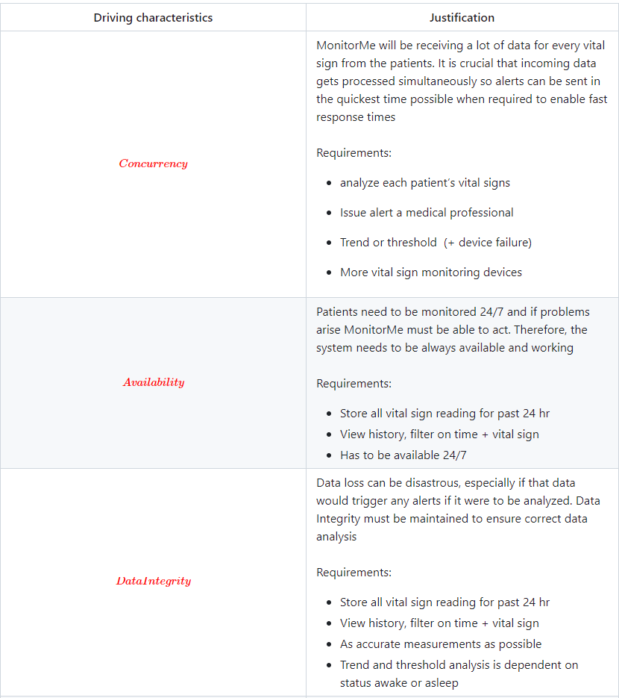
(Justification tekst gebruiken om top-3 toe te lichten)
DEZE SLIDE NIET TONEN

Slide 12
Software Complexity
Availability
Software architecture
style?
Concurrency
Data integrity
Fault-tolerance
Performance
Evolvability

Slide 13
Hardware Complexity
On-Premise
Hardware architecture
style?
24/7 availability
Futureproof
Easy to install
Rolling upgrades
No single point of faillure

Slide 14
Architectural Design Decisions
Jeroen

Slide 15
Software Complexity
Availability
Software architecture
style?
Concurrency
Data integrity
Fault-tolerance
Performance
Evolvability

Slide 16
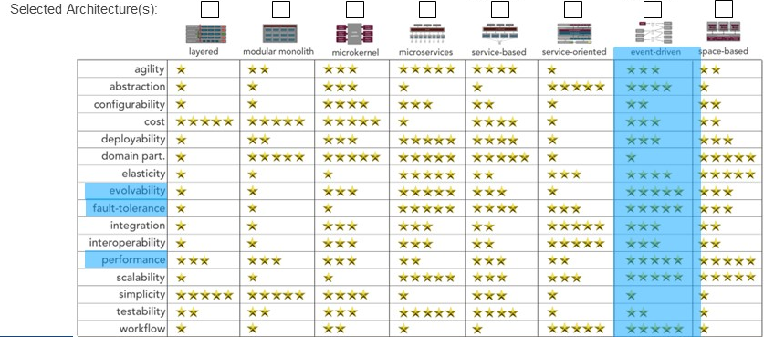
ADR-0000 Event-driven software architecture
Evolvability
Fault-tolerance
Performance

Slide 17
(ADR-0001) Event-driven architecture will not tick all the boxes
Non-functional requirements for MonitorMe are:
24/7 availability
Means no single point of failures
Has to be on-premise; Preferably customer can replace faulty appliances
Meaning easy to install, support rolling upgrades
Futureproof; scalable to support additional vital signs
Considered options:
Centralized systems
Microservices
Distributed systems
Notes:
Centralized system; will make thing a lot easier to build and develop, but it will not support our non-functional requirements like having no single point of failures. Our customers will also be left wondering how we garantee 24/7 then.
Microservices can provide all NFR’s. However, it requires a quite complex hardware infrastructure to maintain

Slide 18
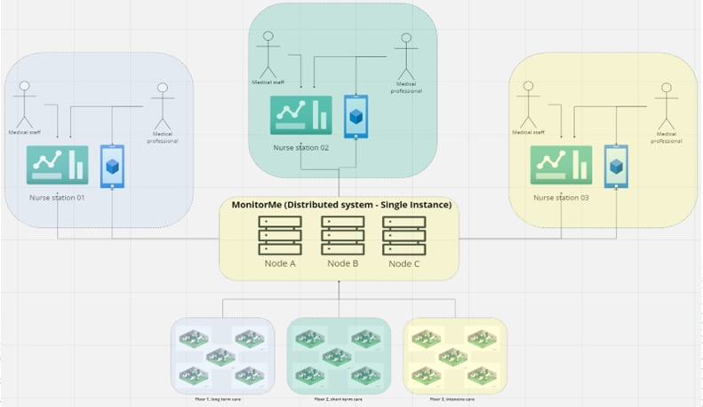
Decision outcome
Chosen option “Distributed system”
Why? It enables all non-functional requirements
Centralized system lacks fault-tolerance
Microservices requires a more complex architecture to support. Which would be preferable in a cloud environment, but not on-premise

Slide 19
MonitorMe Solution
Shahin

Slide 20
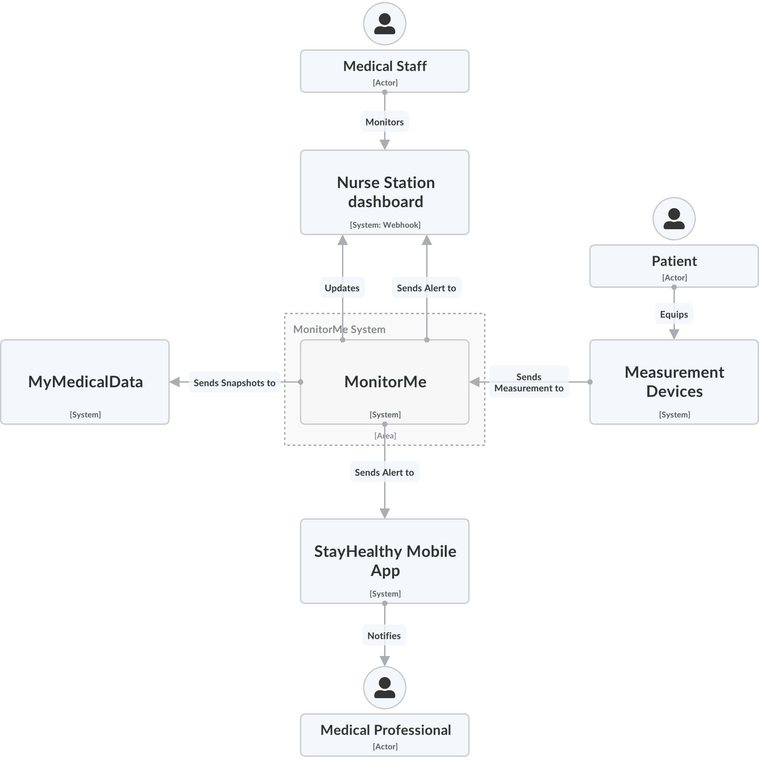
MonitorMe Solution – Level 1
Notes:
We have 3 kind of actors that interact in some way with the MonitorMe system.
Our System is built for ease of use, and built-for change.
For that we will take a look under the hood *Click*

Slide 21
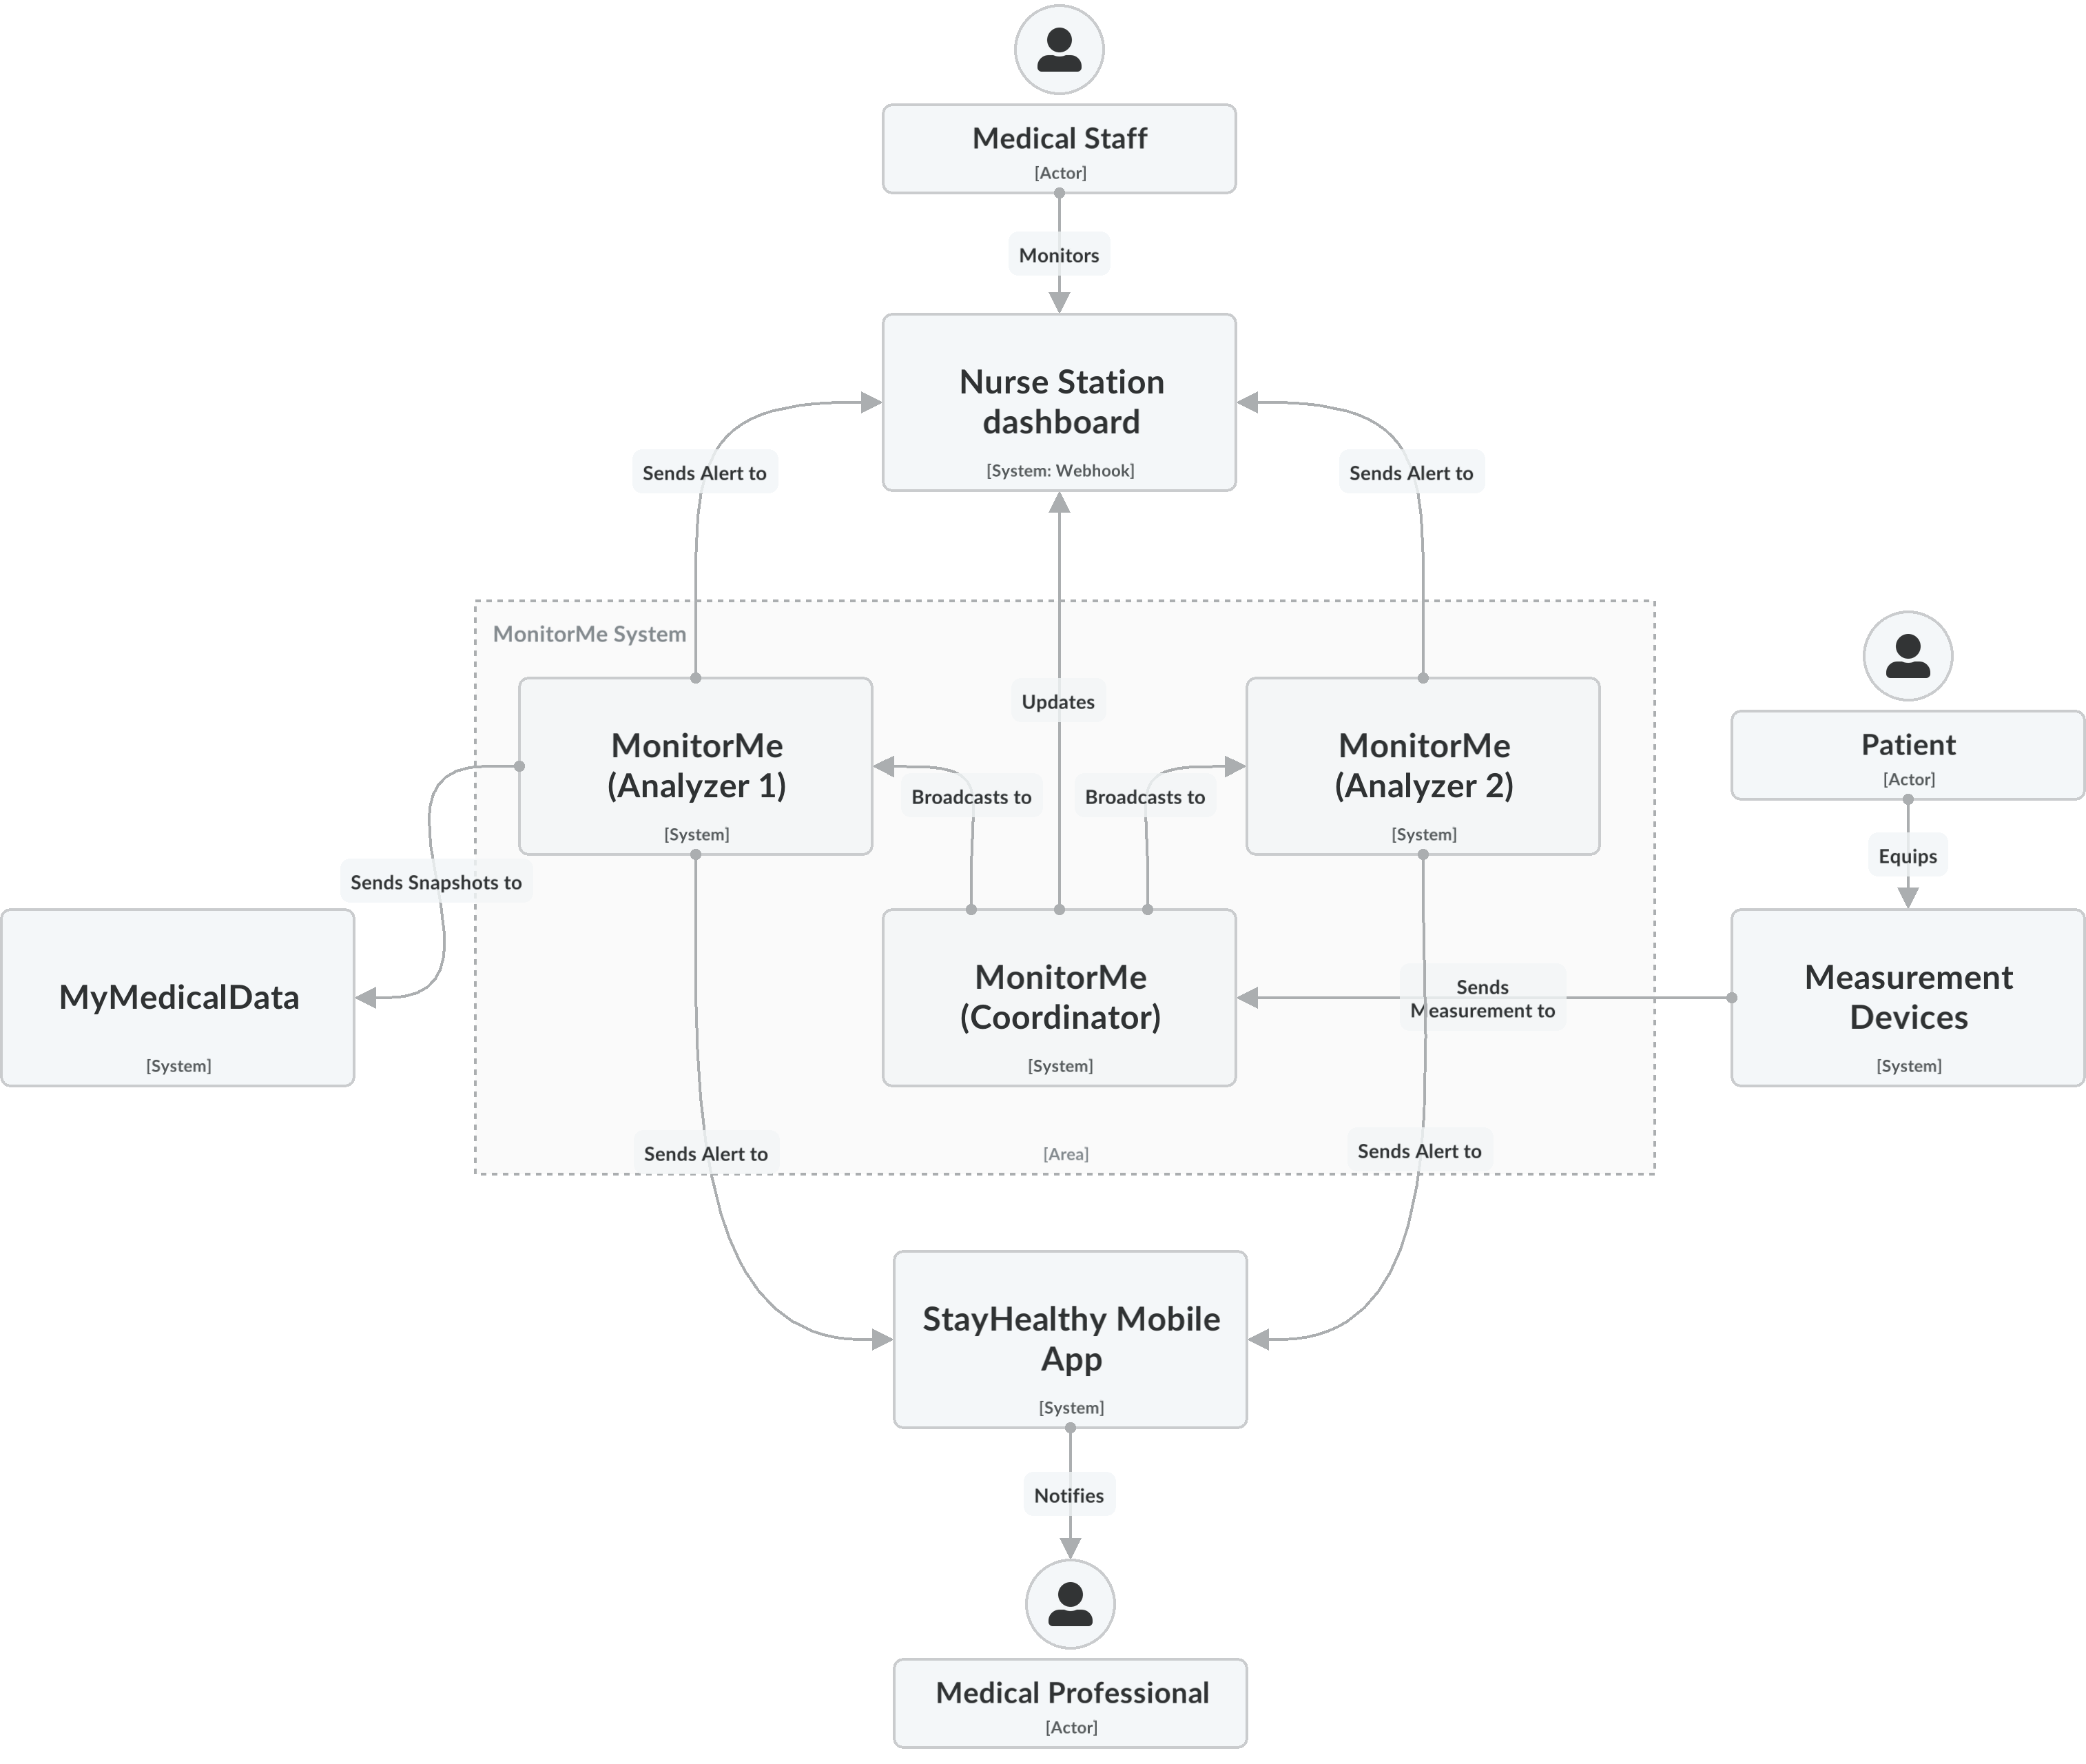
MonitorMe Solution – Level 1
Notes:
To ensure high availability in the event of component faillures or upgrades, we’ve introduced a 3-node concept in MonitorMe consisting of 3 identical units with different responsibilities based on their role.
The coordinator ensures every measurement received from the devices is replicated in the two analyzers. Coordinator also updates the dashboards, allowing the analyzers to focus on trend analysis and alerting.
Historic raw data is stored in all three components. Should one of the monitor me nodes fail, the other 2 become aware of this, they have everything they need to keep the dashboarding and analysis going.
StayHealthy is automatically notified of a faulty node, and sends a courier over to deliver the new node and return the faulty one. All that is left for the customer to do is to plug the node in the system.
Auto configuration and sync kicks in, and in no time you have maximum availability back again.

Slide 22
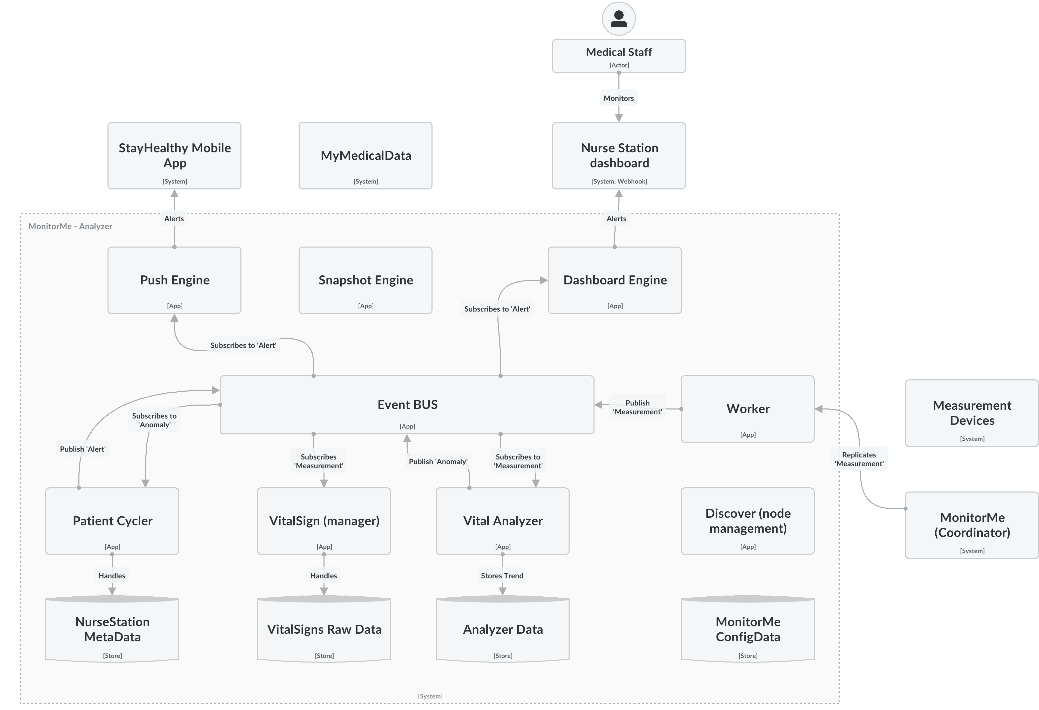
MonitorMe Solution – Level 2 Analyzer
Notes:
For the techies, let’s check how the event system works. We’ll focus on the analyzer role for now.
1.

Slide 23


Wrap-up MonitorMe
READ DATA VITAL SIGN INPUT SOURCES
ANALYZE VITAL SIGNS & ALERT MEDICAL PROFESSIONAL
COMPLETE OWN INSTALLATION
RECORD & STORE DATA 24 HOURS
AWAKE OR ASLEEP TREND AND THRESHOLDS
MAX 500 PATIENTS PER INSTANCE
DIFFERENT RATE VITAL SIGNS READINGS
PUSH NOTIFICATION
TO MOBILE APP
ON-PREMISES ARCHITECTURE
CONTINUITY IF AN INPUT SOURCE FAILS
GENERATE HOLISTIC SNAPSHOTS
ACCURATE MEASUREMENTS
BUILD-FOR-CHANGE
MORE VITAL SIGN DEVICES
SECURE PATIENT DATA

Slide 24
Happy End
Team Low-Code

Slide 25
